Slide 1
“The operation & importance of version control in the software life cycle.”
Tuilla Chaves
Adam Stafford
Tim Allman
Team P(hantom)

Slide 2
1. What is version control?
Version control is a system that records changes to a file or set of files over time so that you can recall specific versions later.
Generally it is a piece of software that archives a complete history of all work completed by, for example: a Software Development Team

Slide 3
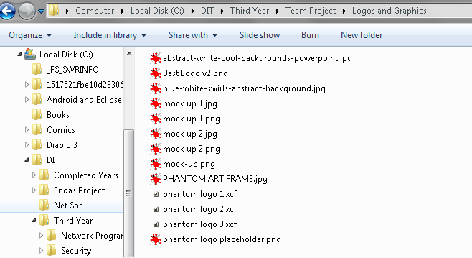
2. Types of version control
Local - Many people’s version-control method of choice is to copy files into another directory (perhaps a time-stamped directory, if they’re clever).

Slide 4
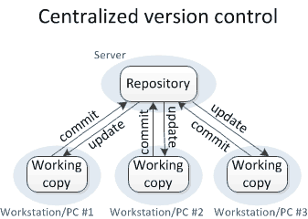
2. Types of version control
Centralized - have a single original copy on a server and each developer commits changes to a central copy only. Locks are important.
CVS (Current Version System), SVN.

Slide 5
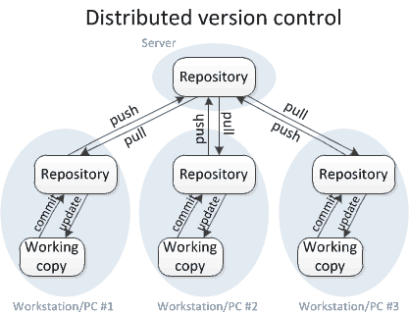
2. Types of version control
Distributed - every user has a copy of the full code.
Git, Mercurial.

Slide 6
3. What does a Version Control System?
Backup and Restore.
Synchronization.
Short-term undo.
Long-term undo.
Track Changes.
Track Ownership.
Sandboxing.
Branching and merging.

Slide 7
4. Why use Version Control?
Version Control allows you a place to store your work as it progresses, and allows you to instantly recall any work from any point in time.
It also can allow others to recall communal (or just your) work at any time, in a read only fashion, or also to make changes themselves.

Slide 8
5. Why is it Important?
Keeps people sane.
Tracks all changes made to files so you dont have to worry about losing source code or files.
Provides users with statistics and troubleshooting options.
Allows developers to collaborate on almost the same code at the same time through branching.
Permits developers to modify any previous code for use say as a template for other projects.

Slide 9
6. Case Study: Github
Github serves as a distributed version control system through a central master repository.
All team members clone that repository to their own local machines or branch from the master repo in order to work on code.
When members want to upload changes they push to github and commit those changes.
With branching, members will have to merge their own branch with the master repo.

Slide 10
6. Github continued...
If problems are encountered at any point after merging or commiting code, team members can rollback changes to a previous working state with little effort.
Github allows anyone to access other publicly available repos (Pulling) and propose changes to the owner’s code for everyone’s benefit.

